Slide 1

Diffusion of Solar Photovoltaics and Role of Extremists
Photo: EWZ
Jordi Fornt-Mas, Sourya Kovvali, Alejandro Nuñez-Jimenez, Marius Schwarz
Project for the lecture: Agent-Based Modeling and Social System Simulation, FS-2019, ETH Zurich December 9, 2019

Slide 2
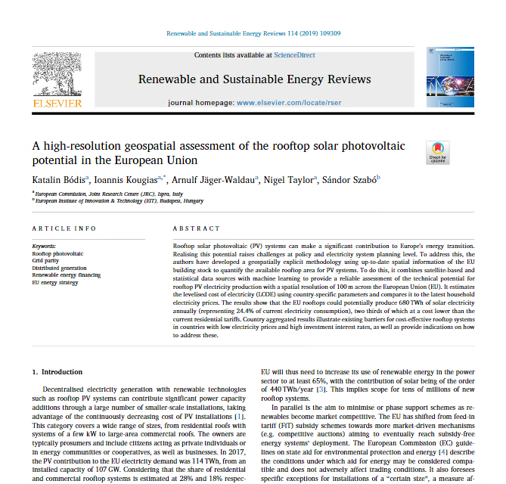
Motivation
Cities account for three-quarters of human-caused global CO₂ emissions
Solar PV on the rooftop of buildings could generate 24% of Europe’s electricity demand
Cities account for two-thirds of global final energy use
Bódis et al. 2019
REN21, 2019

Slide 3
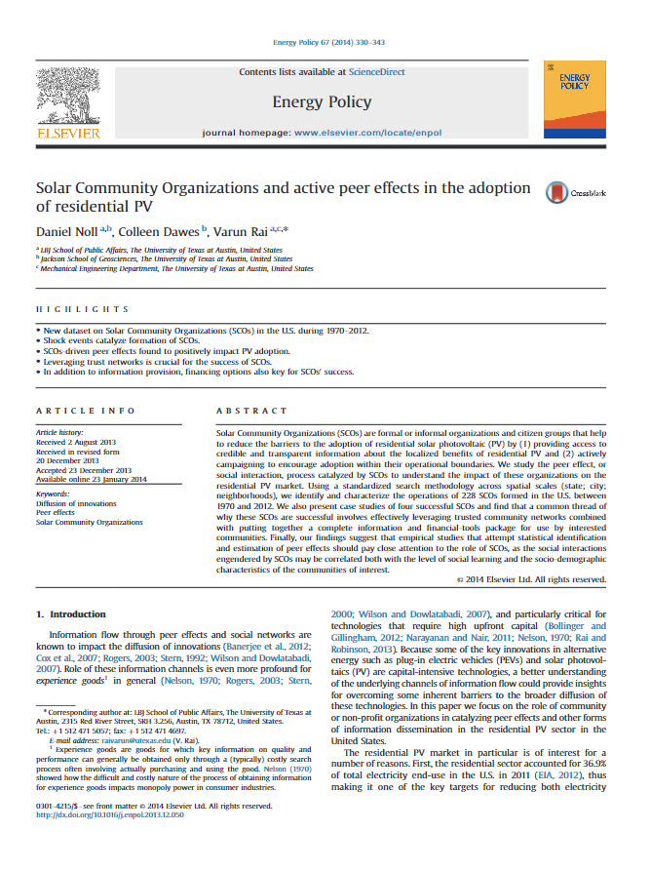
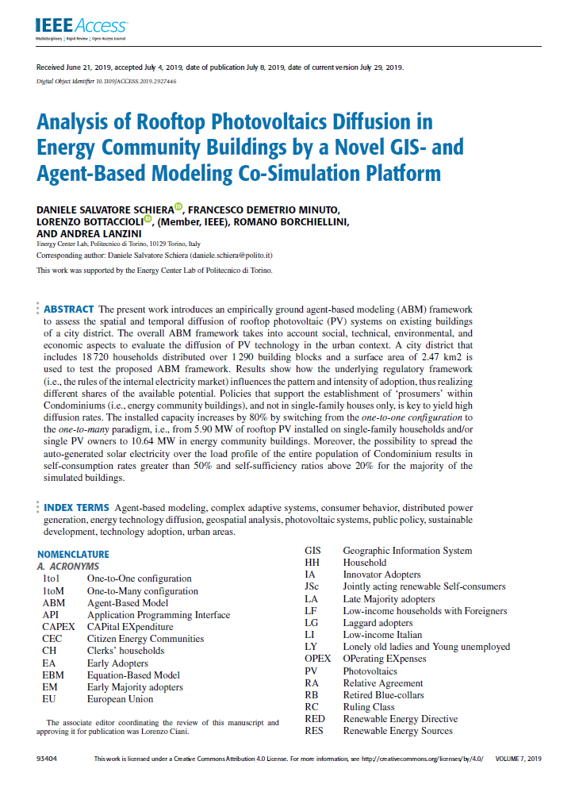
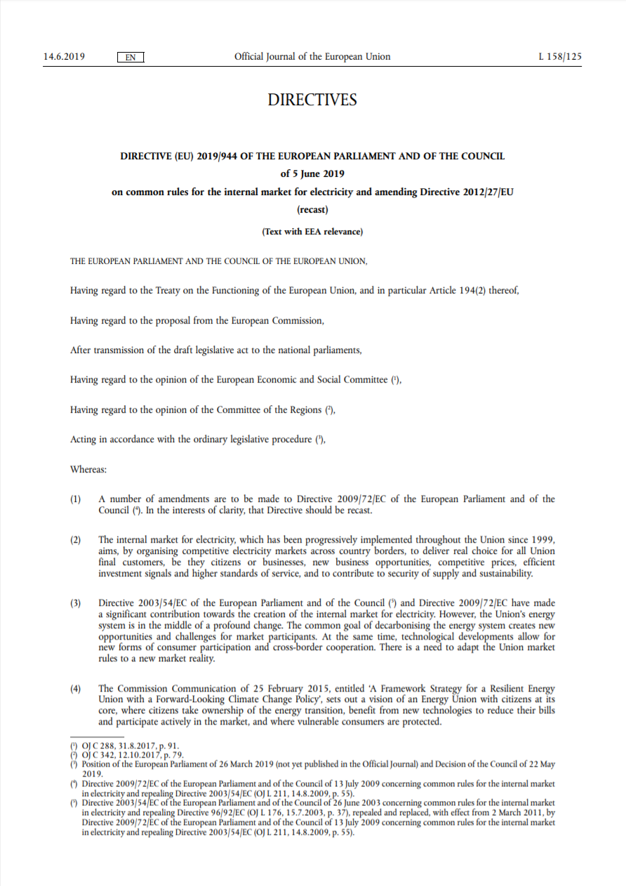
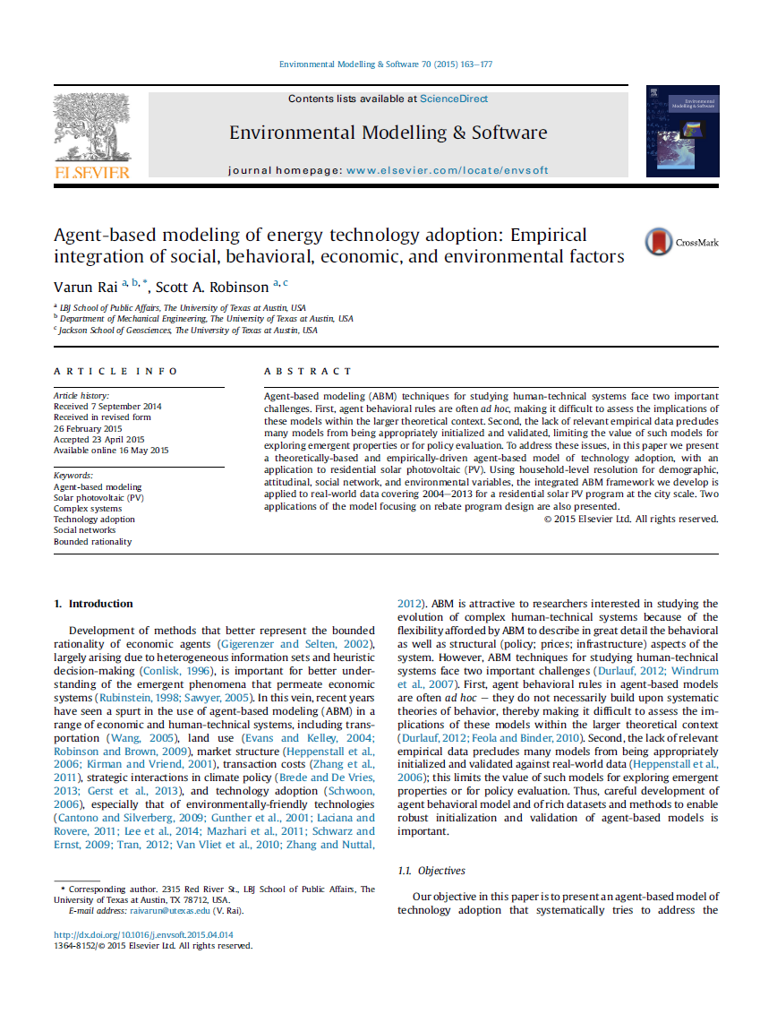
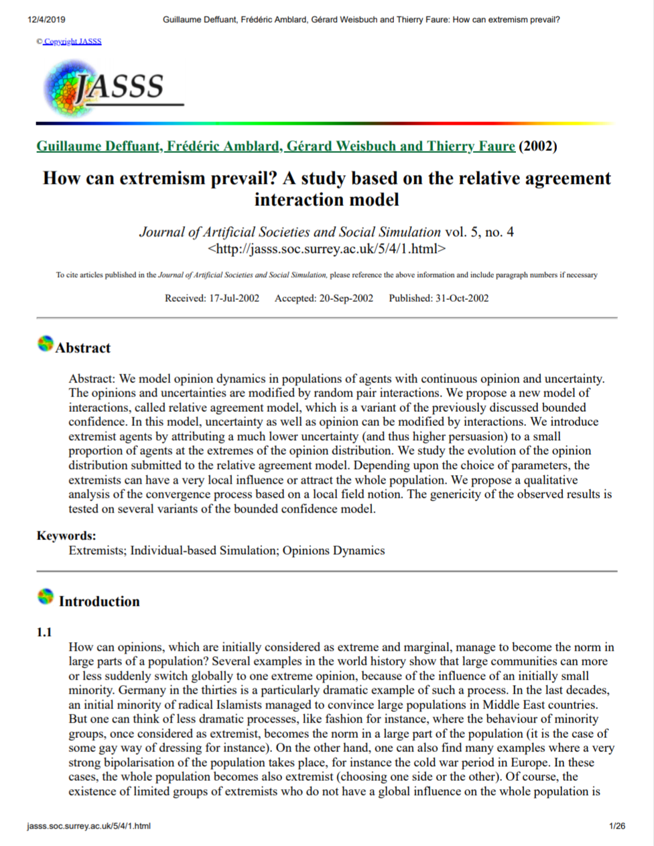
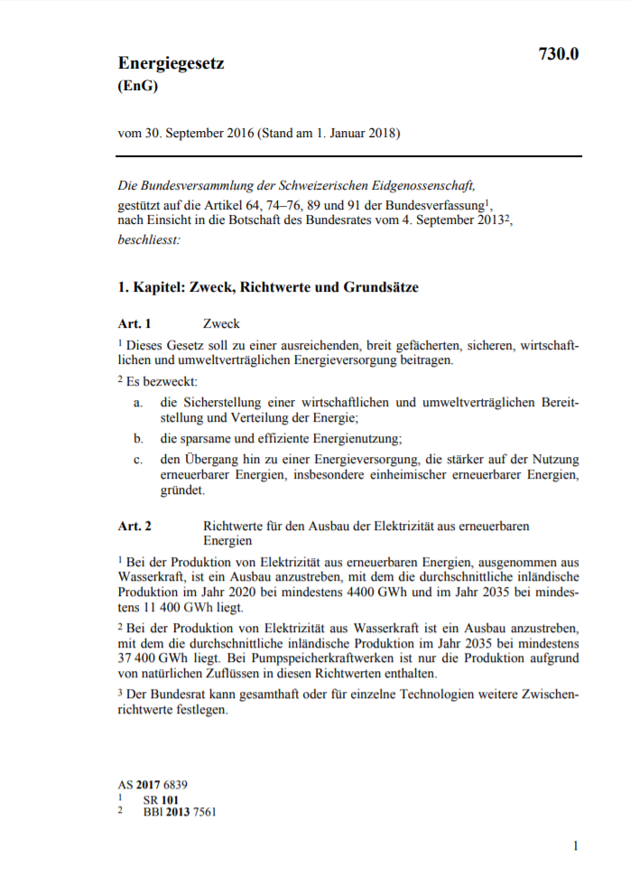
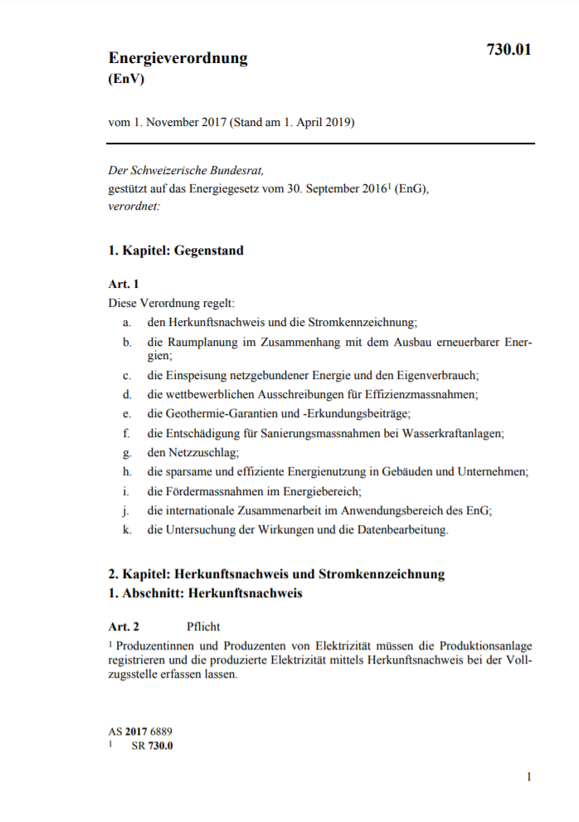
Motivation
Empirical studies show importance of active peer effects in solar communities
ABMs on solar PV diffusion focus on individual adoption or one-building communities
Policies focus on energy communities to boost the diffusion of renewable energies
Noll et al. 2014
ABMs on opinion dynamics highlight the impact of extremism
Schiera et al. 2019
Rai, Robinson 2015
Deffuant et al. 2002
What is the role of opinion extremists in the diffusion of individual and community solar photovoltaics in cities?
EU 2019/944
CH 2019 EnG, EnV

Slide 4
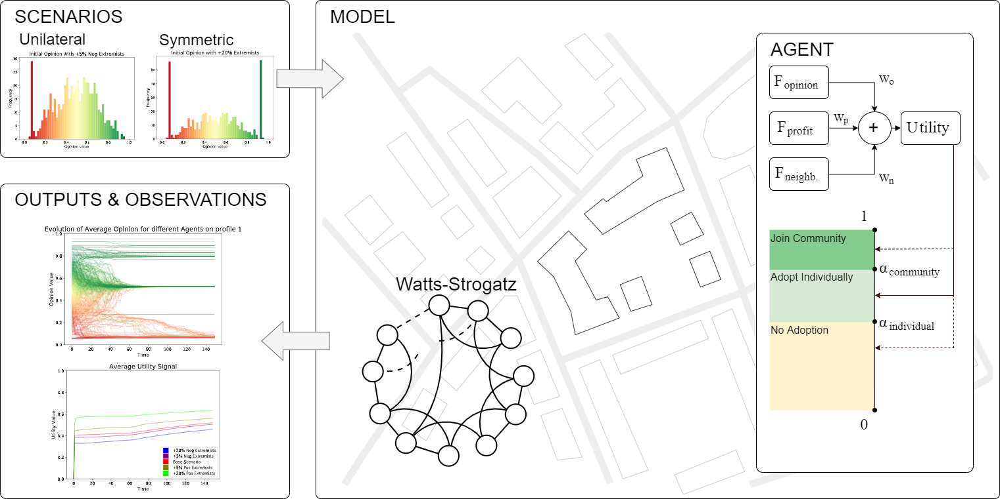
Model and Agents

Slide 5
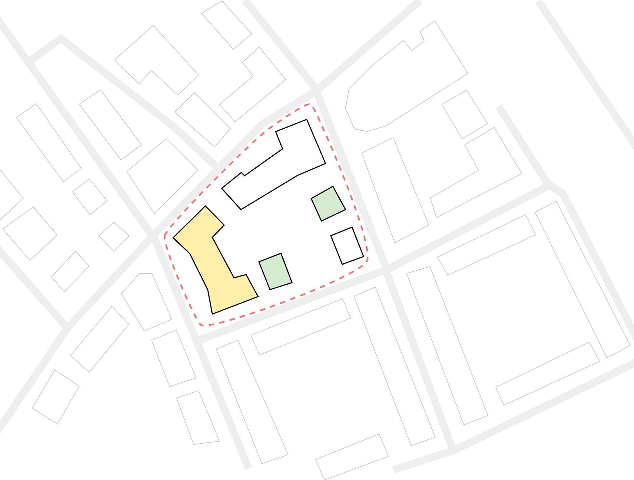
Agent Profitability and Neighbourhood Pressure
Profitability Factor
F_{profitability} = 1 – PT_{i}/PT_{max}
PT_{max} Maximum Payback time
PT_{i} Payback time for agent i
PT_{i} = I_{PV,i} /CF_{PV,I}
= price-per-watt . size
CF_{AC} + CF_{FIR} + CF_{OM}
AC Avoided Costs
FIR Feed-in Remuneration
OM Operation and Maintenance Costs
Neighbor Factor
F_{neighbor} = n_{community}/n_{total}
Notes:
Represented by the ratio of agents in the same block who have enrolled for community solar PV against total number of neighbors in the block
Defined by the payback period of the agent’s investment on installing and maintaining Solar PV

Slide 6
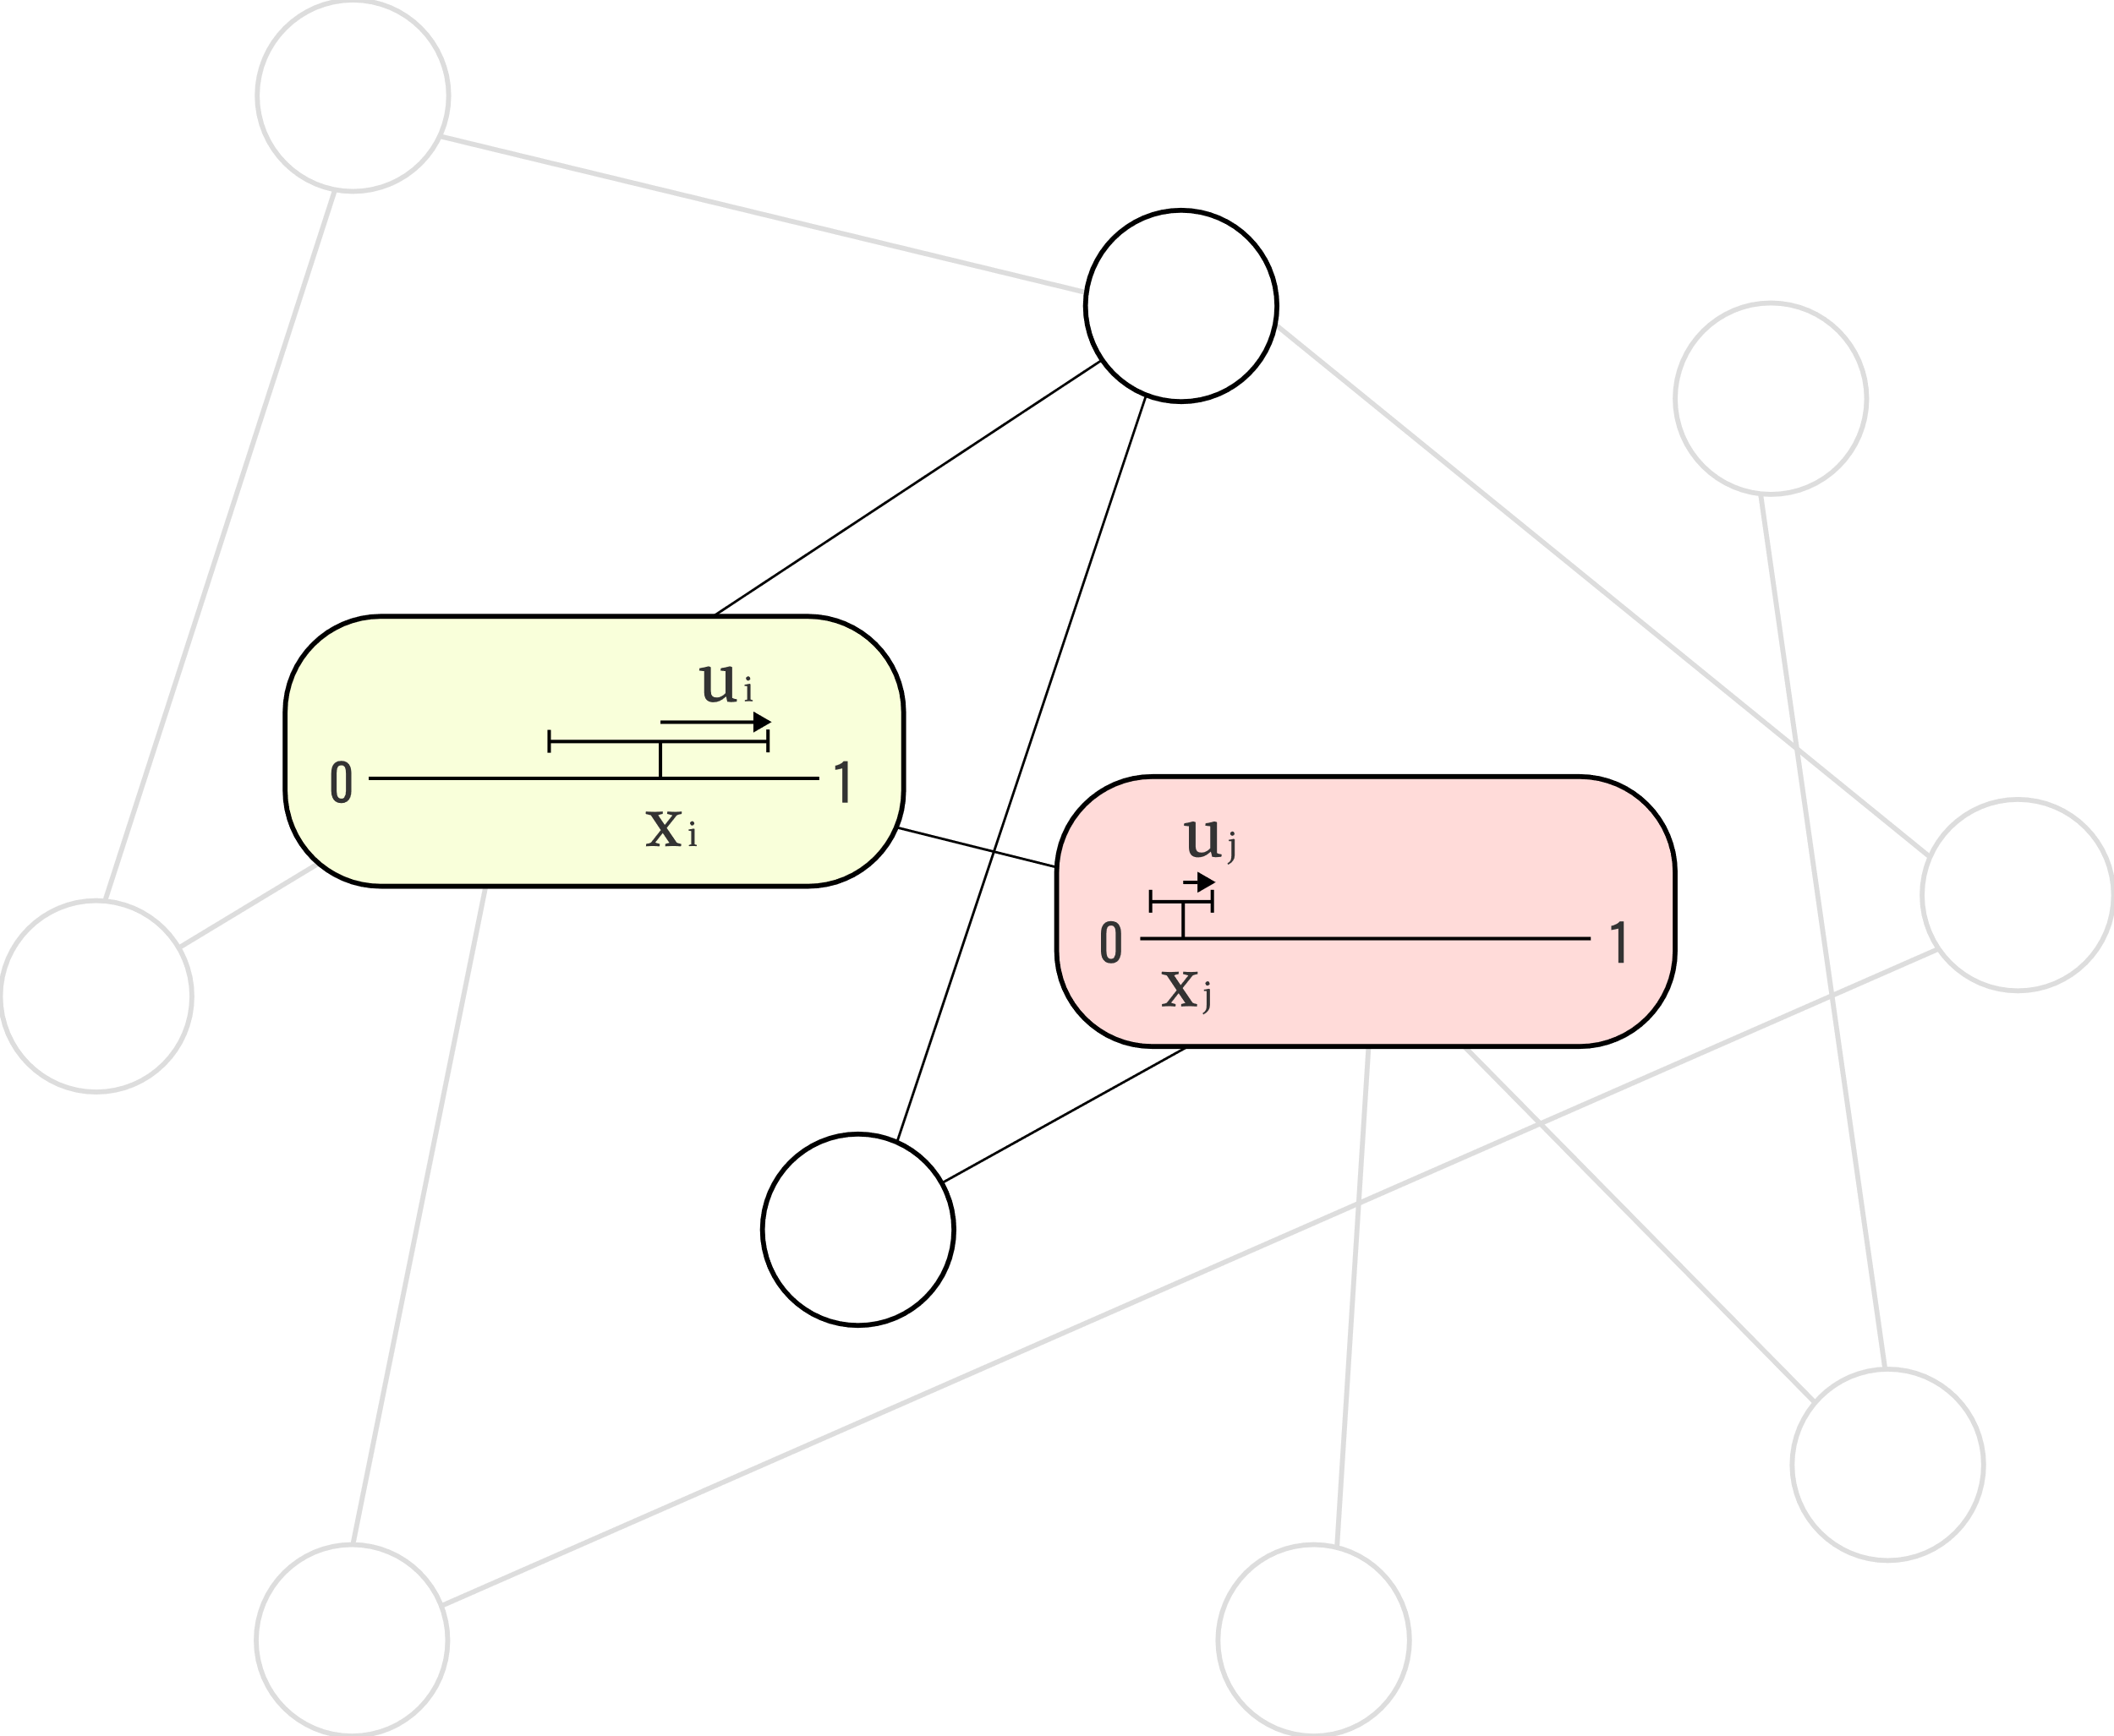
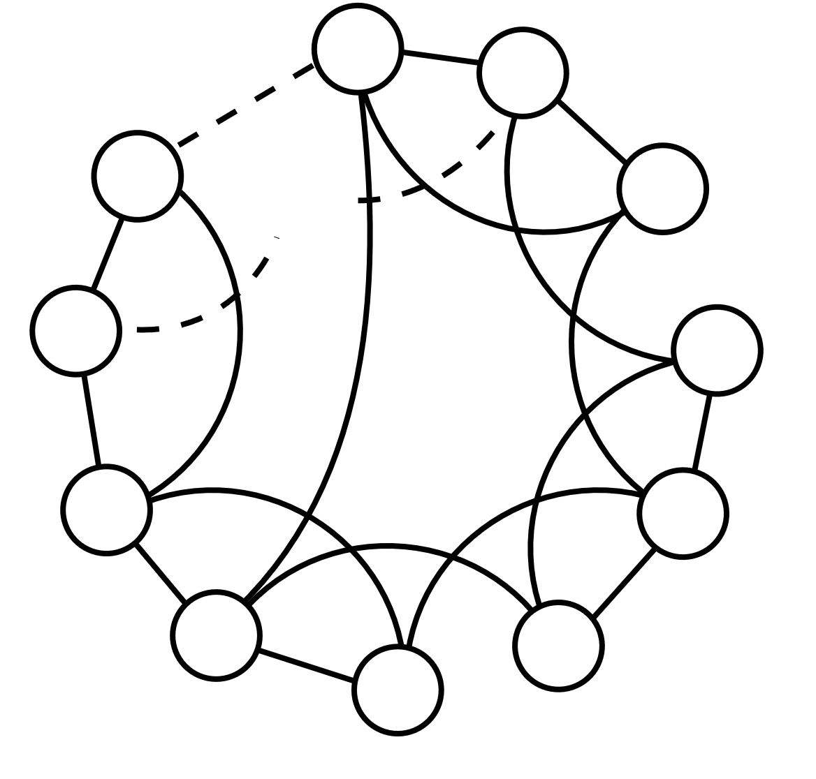
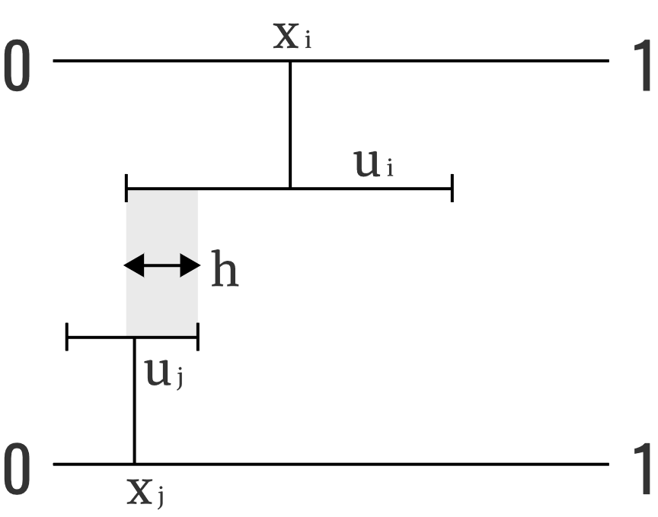
Opinions and Interactions
Watts-Strogatz SWN
Clustering Coefficient 0.24
Average Shortest Path 3.65
Opinion and Uncertainty Model
Opinion of Agent i (F_{opinion}) x_{i}
Uncertainty u_{i} = x_{i} (1 – x_{i})
Relative Agreement Algorithm
ra_{i} = max(0 , h/u_{j} – 1)
x_{i}’ = x_{i} + μ ra_{i} (x_{i} – x_{j})
u_{i}’ = u_{i} + μ ra_{i} (u_{i} – u_{j})

Slide 7
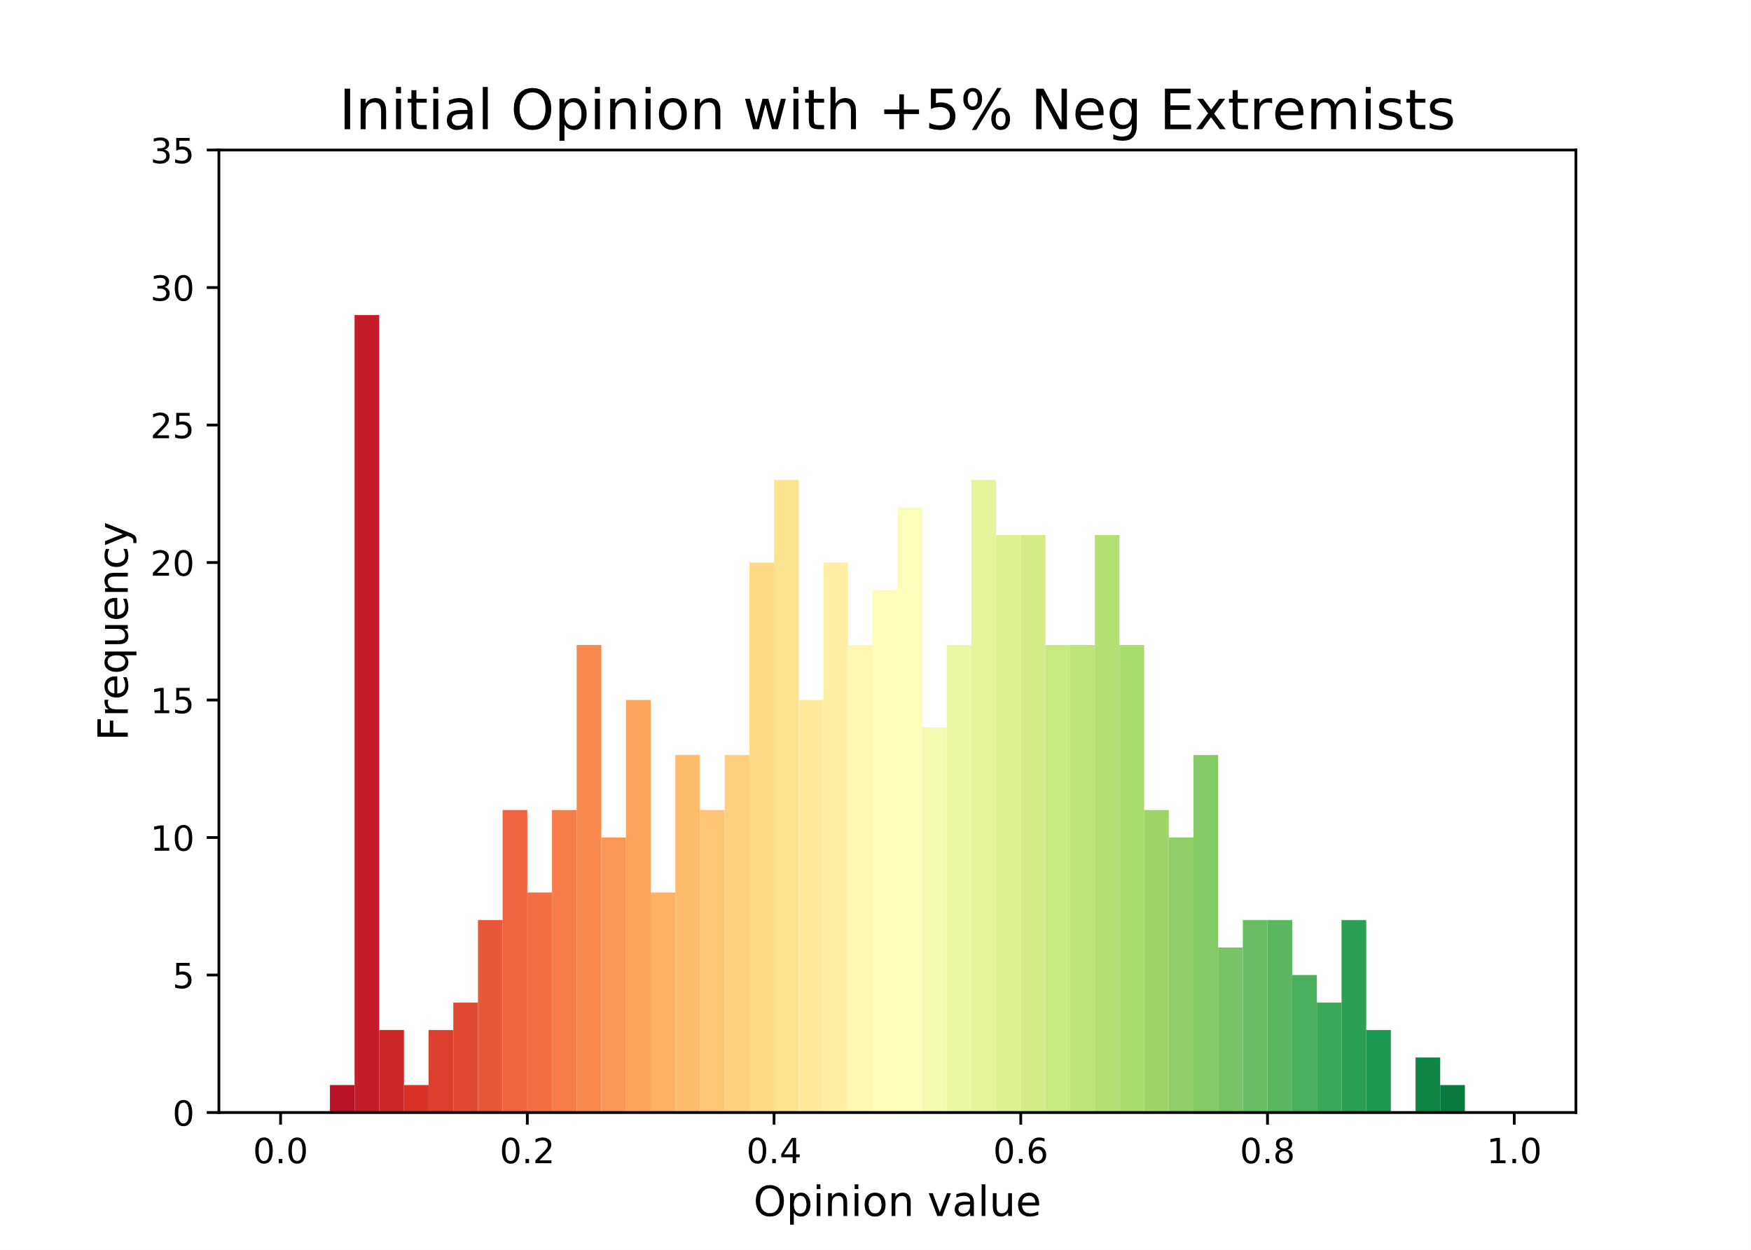
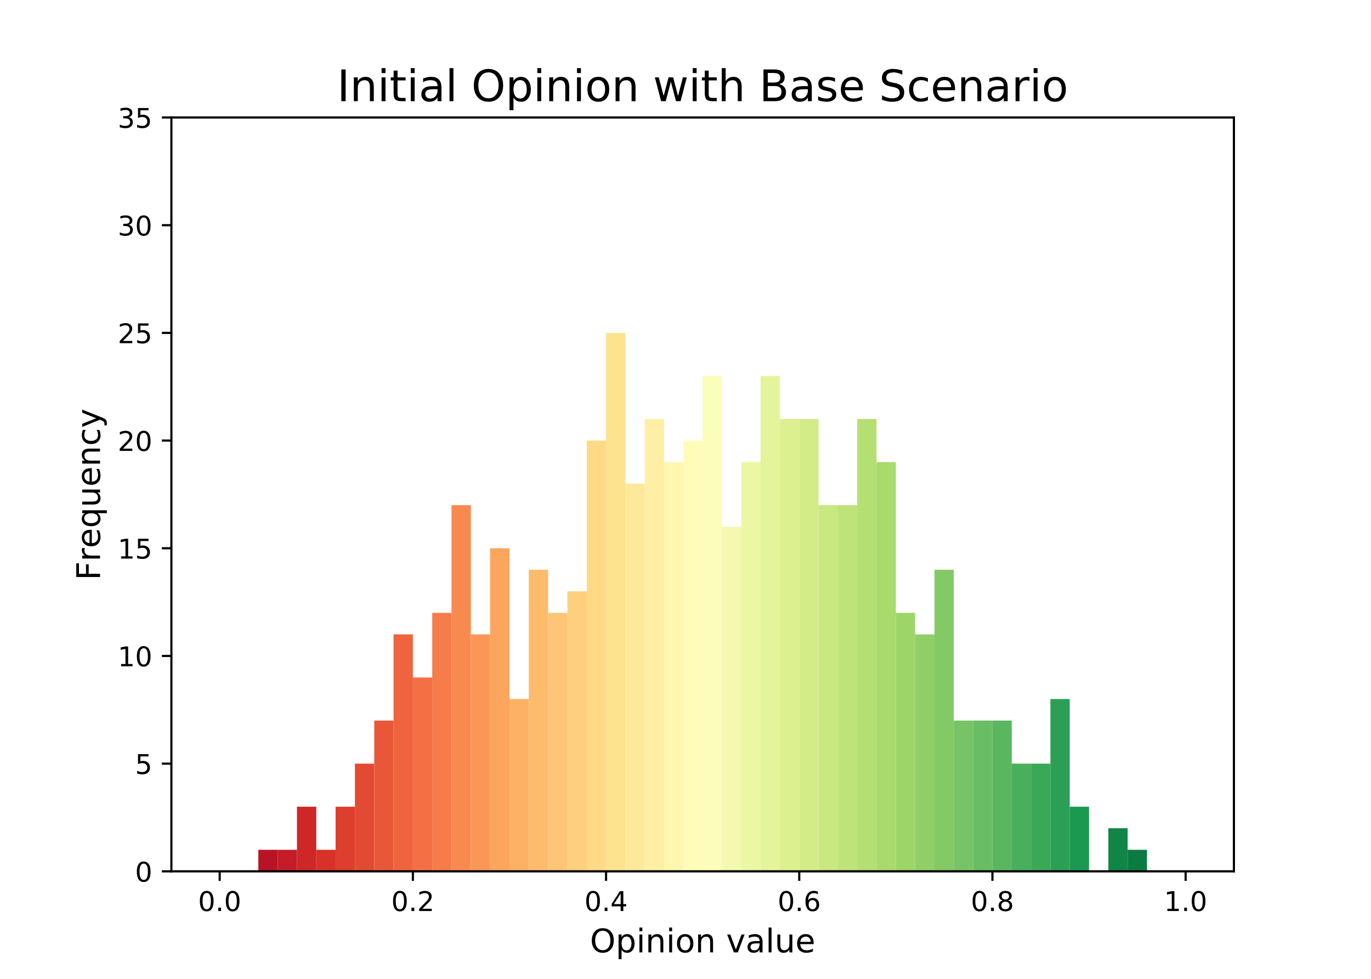
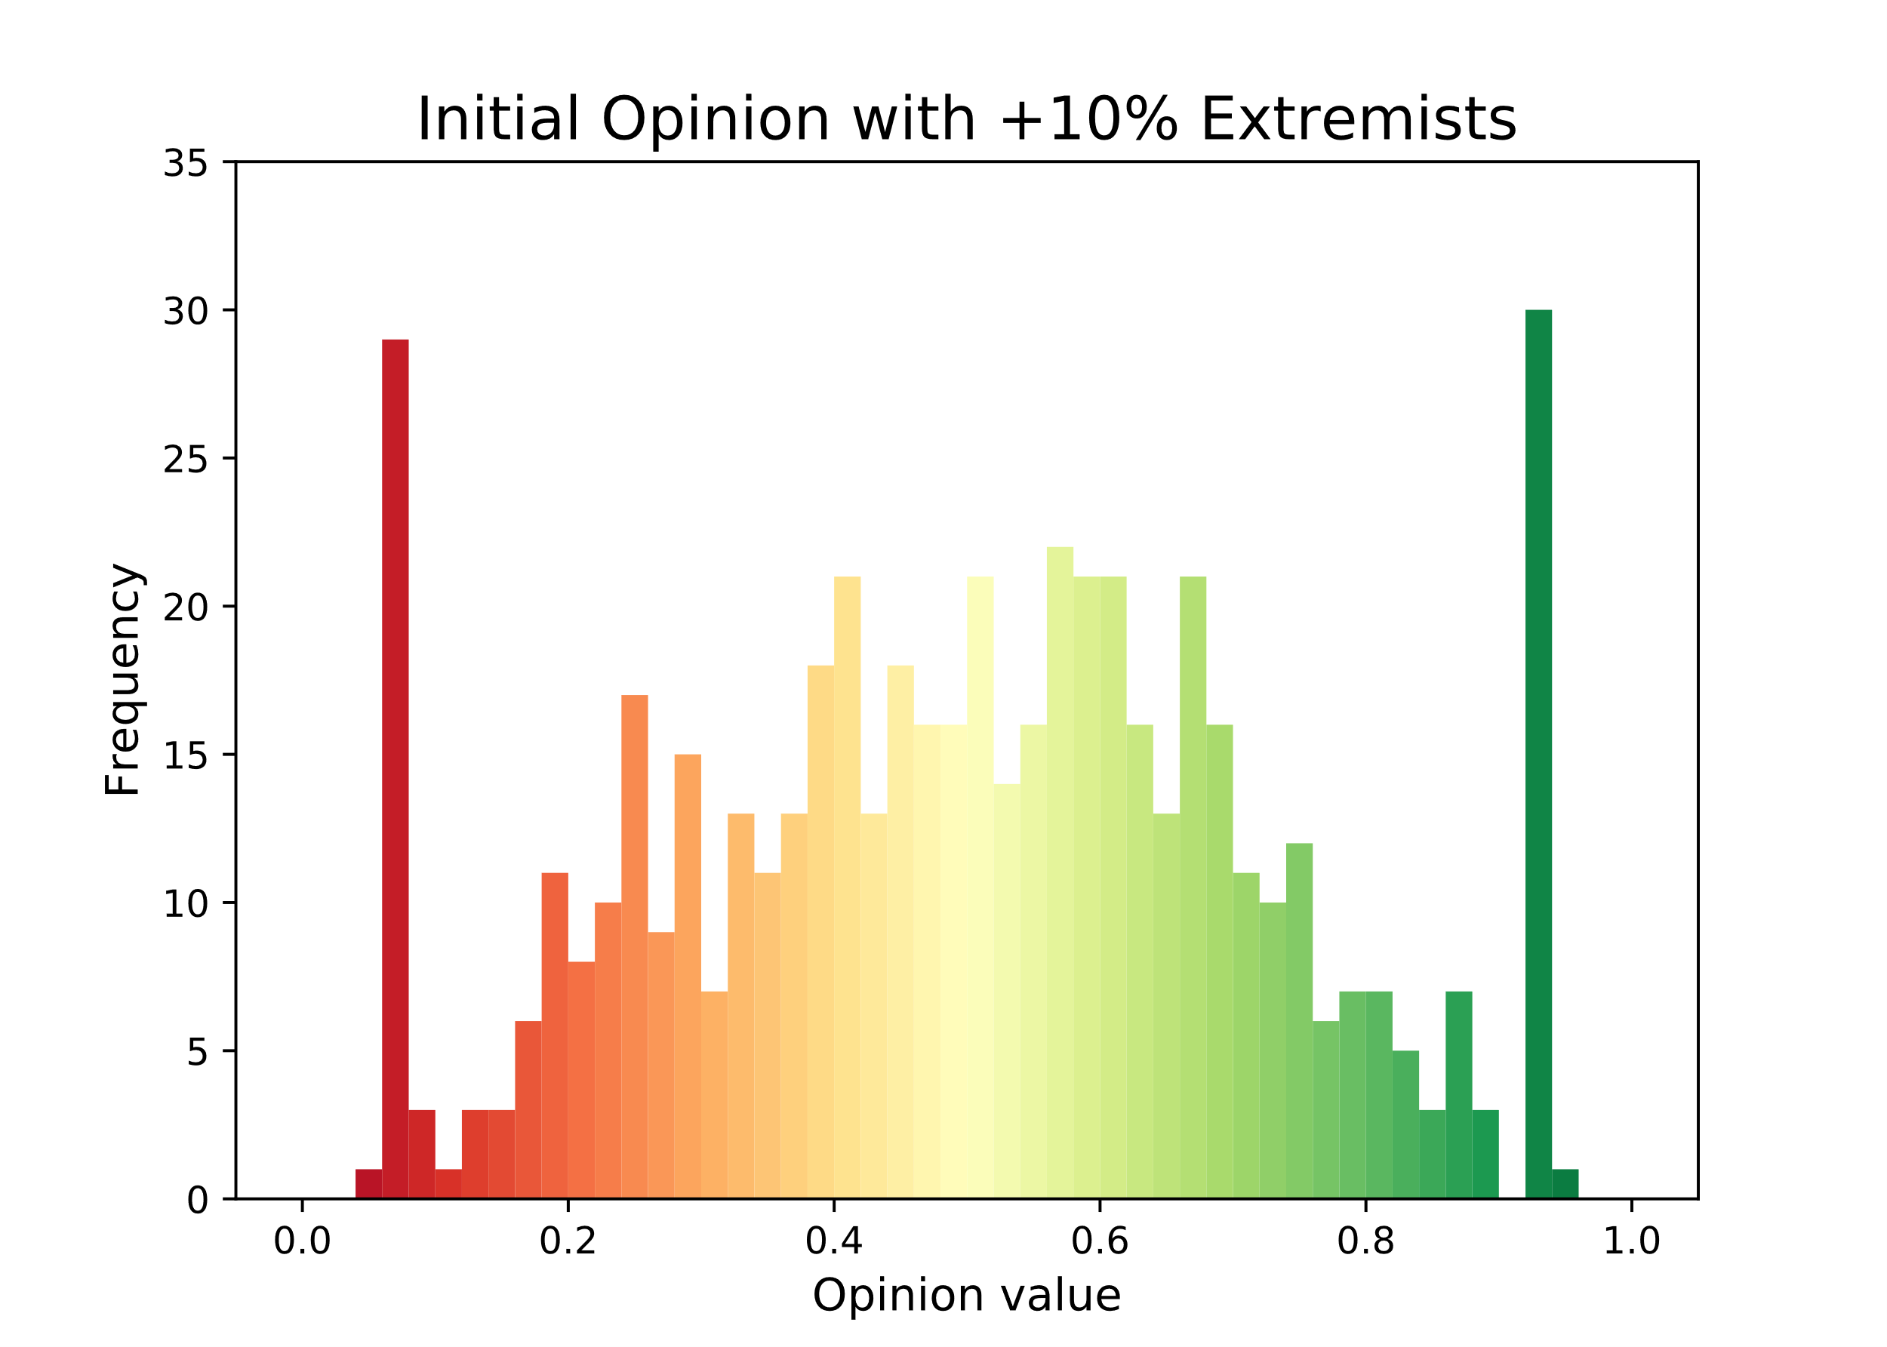

Tested Scenarios
Question: What is the role of opinion extremists in the diffusion of individual and community solar photovoltaics in cities?
One-Sided Extremism
+N% of Pos or Neg Extremists
Symmetric Extremism
+N% of Pos+Neg Extremists
20% N
5% N
Base
5% P
20% P
Base
5% (2.5%+2.5%)
10% (5%+5%)
20% (10%+10%)
40% (20%+20%)
Experiments:
Experiments:

Slide 8
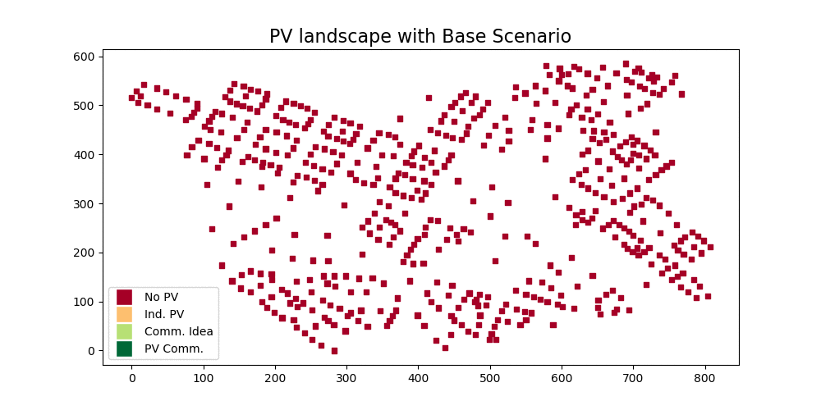
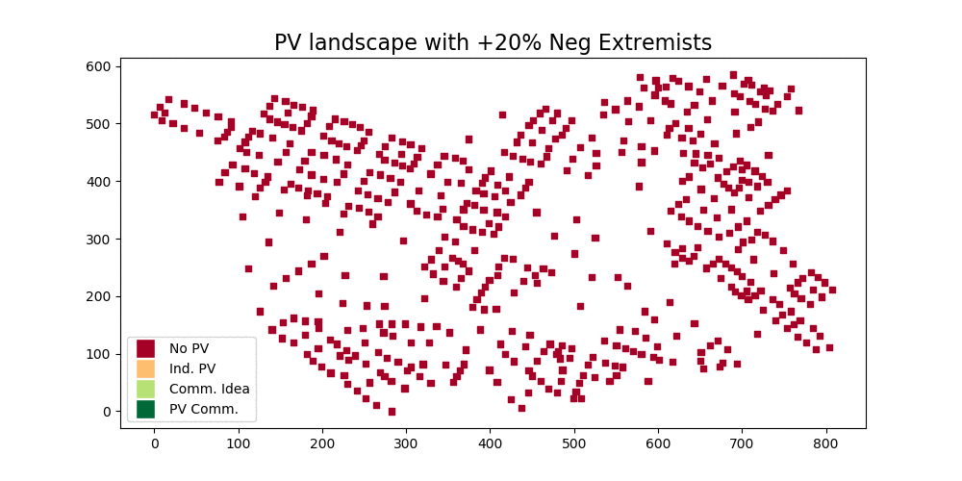


Results and Discussion

Slide 9
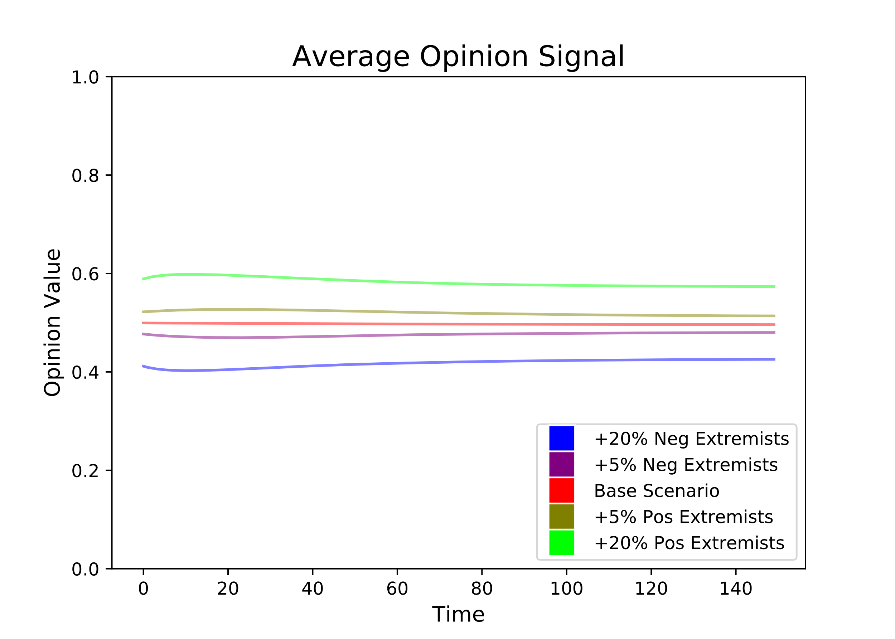
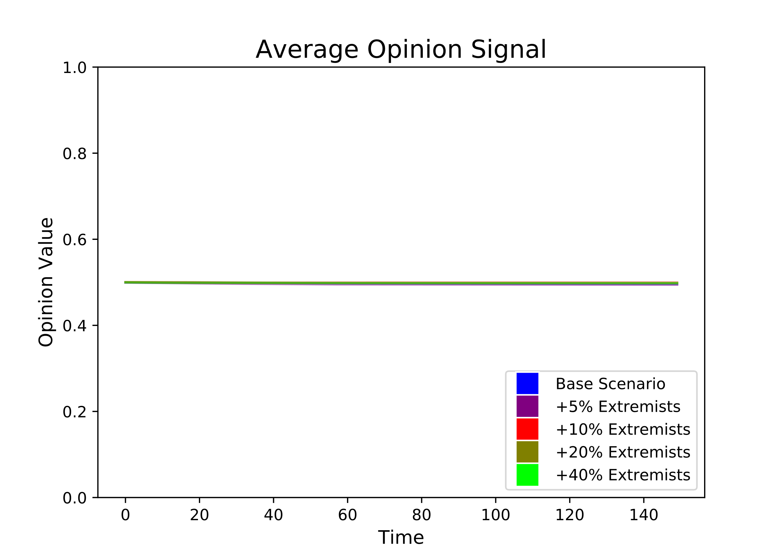
Results and Discussion
One-Sided Extremism
Symmetric Extremism

Slide 10
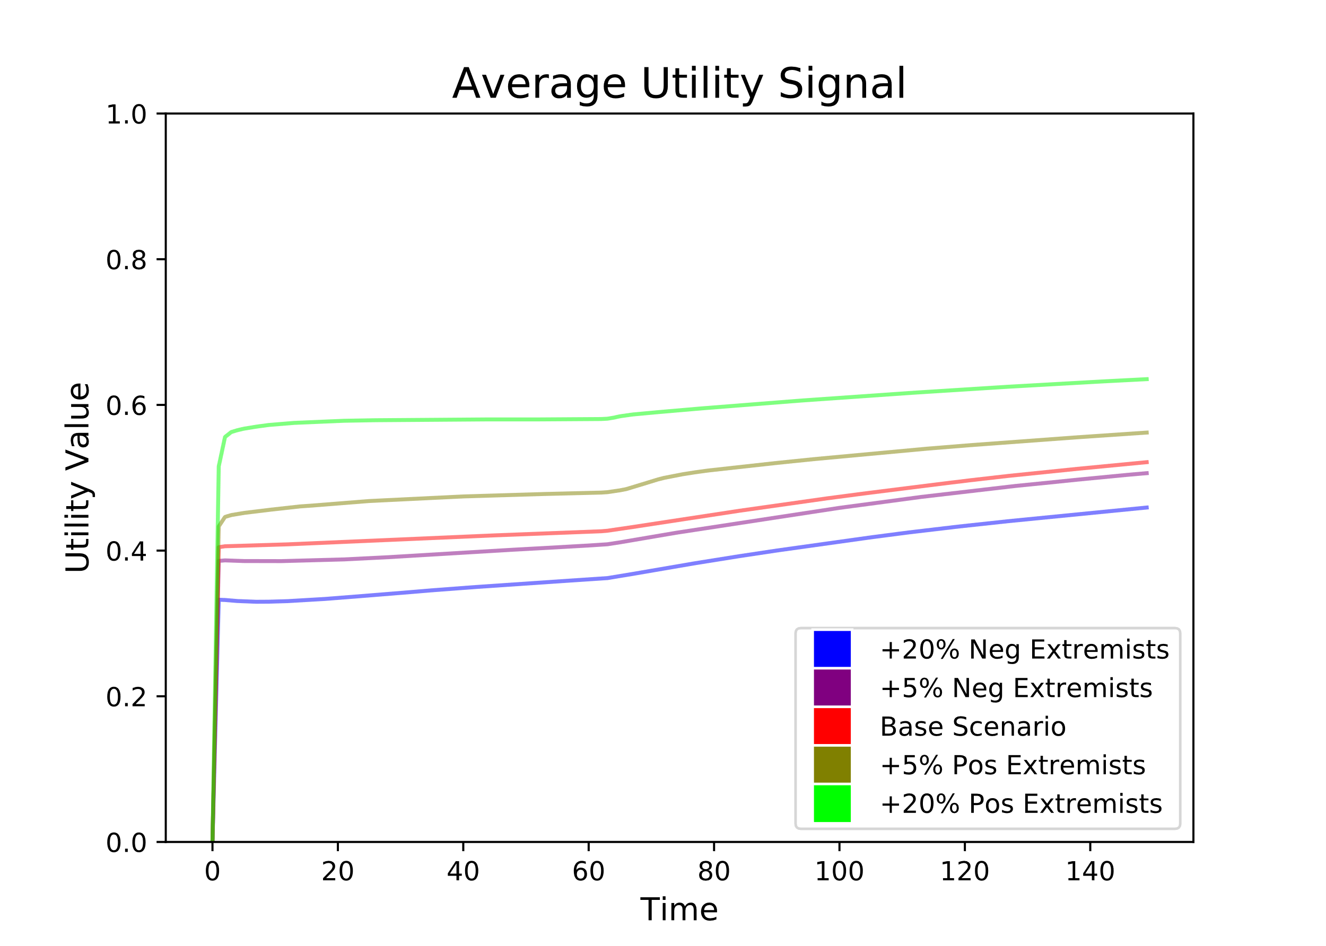
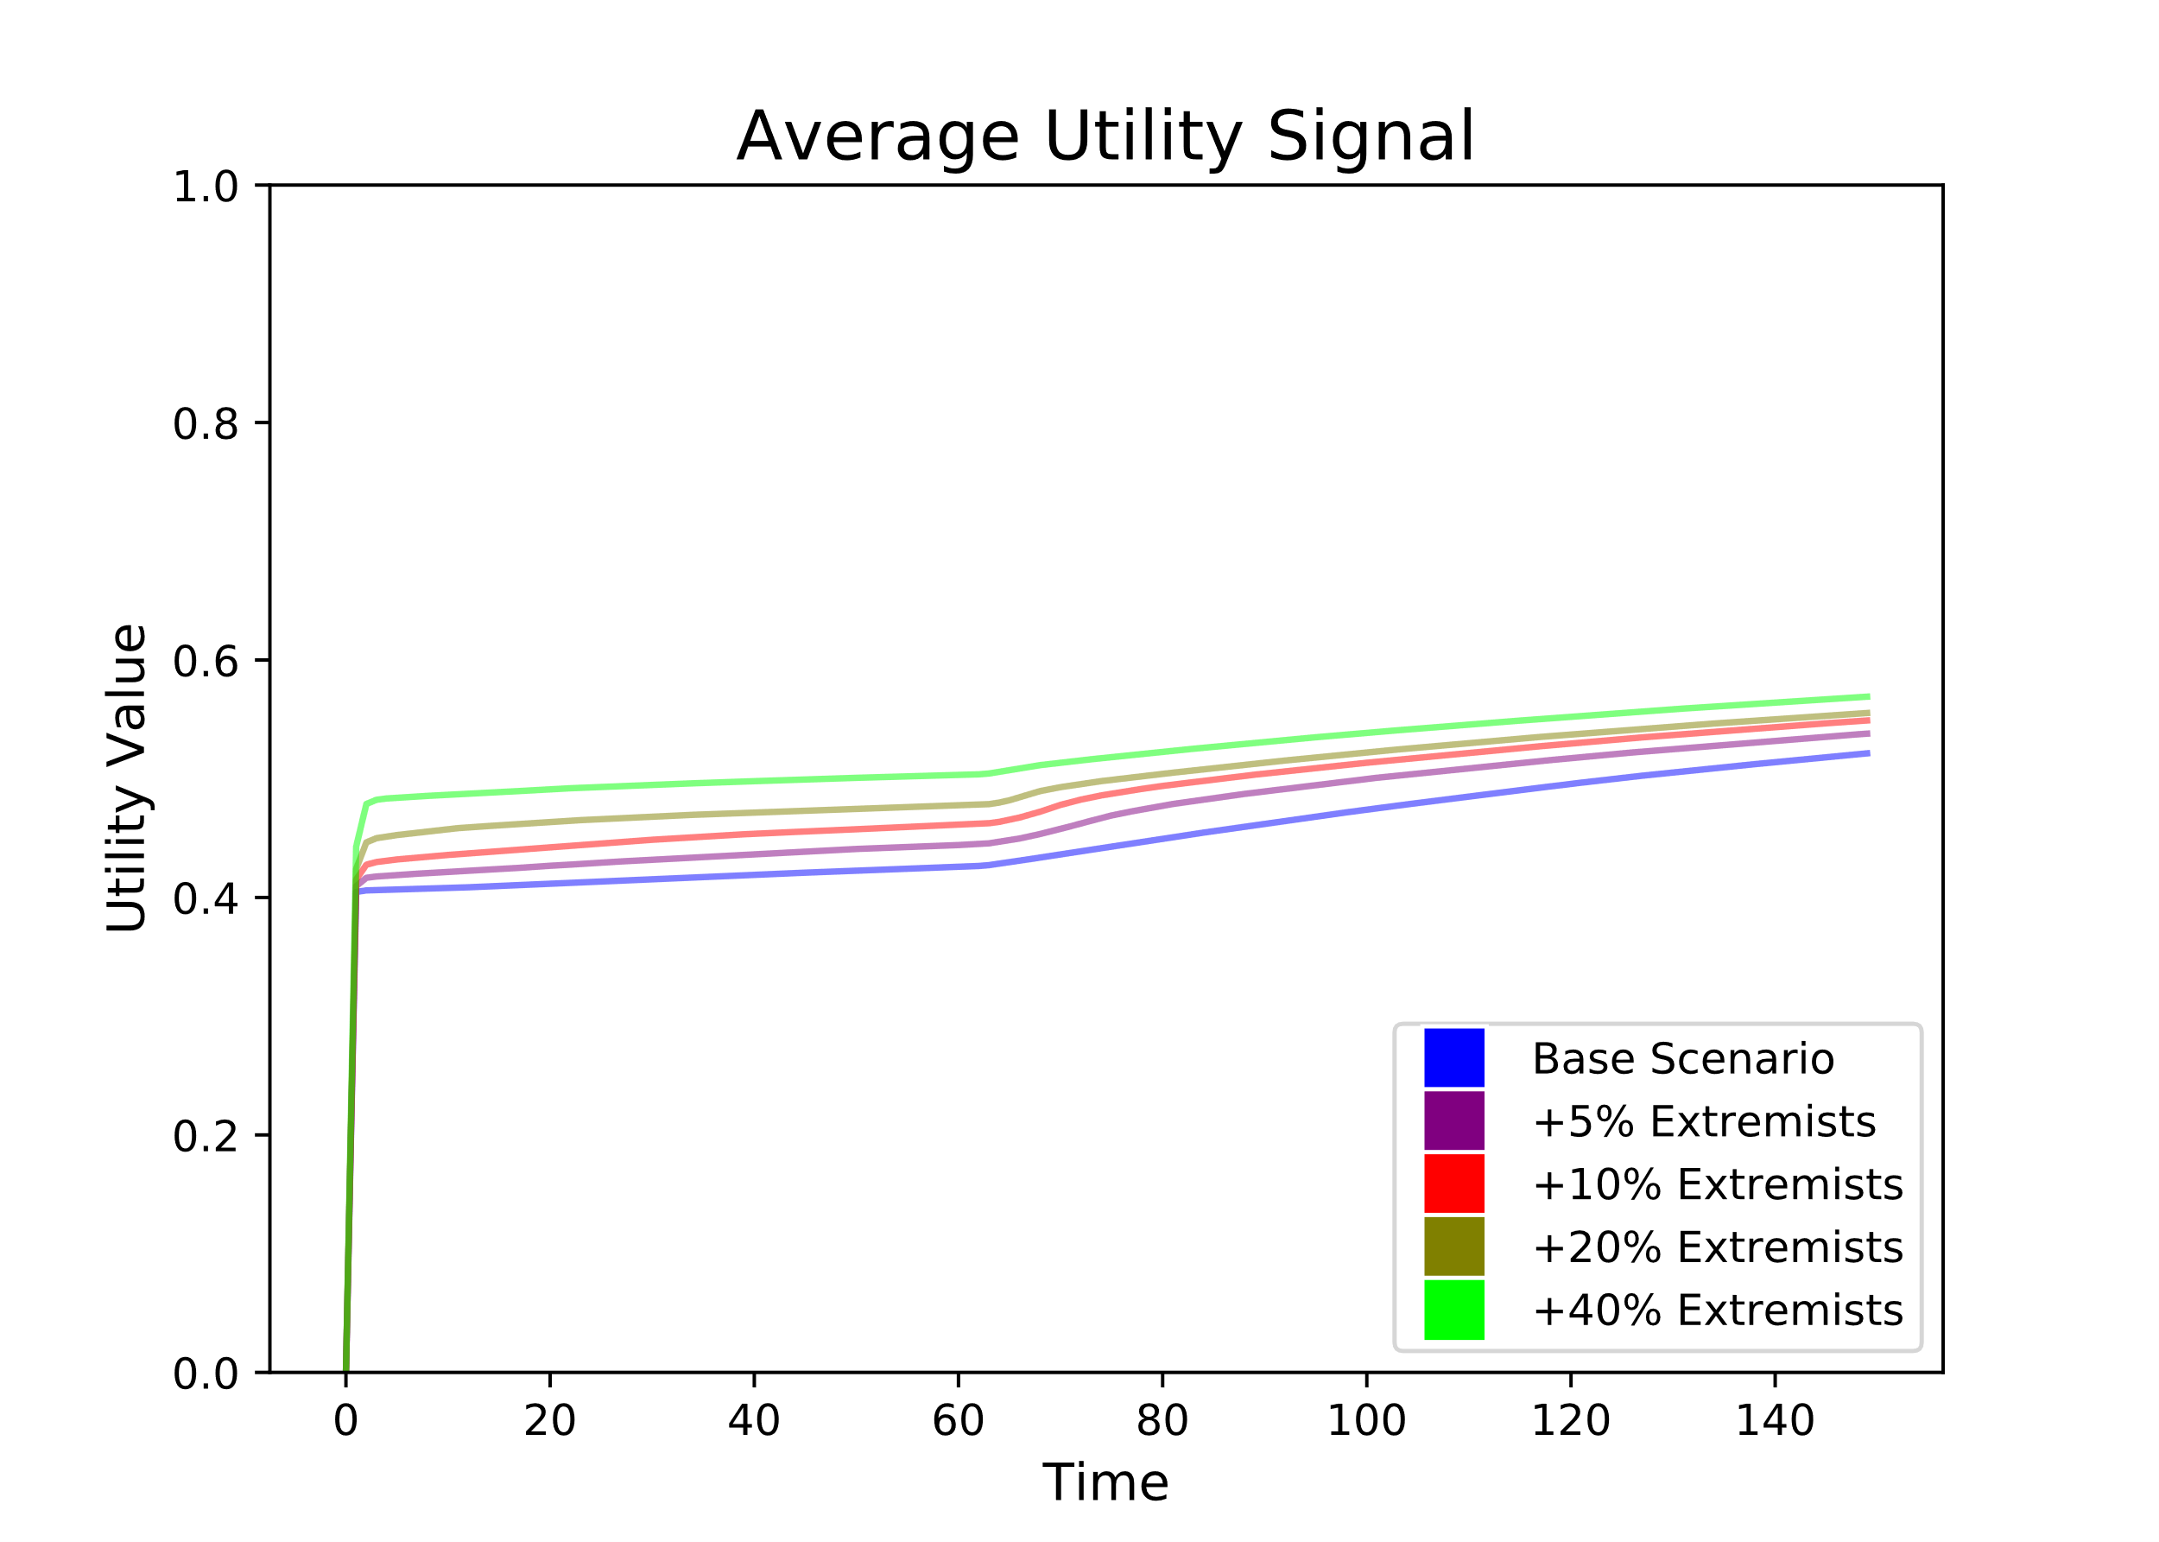
Results and Discussion
One-Sided Extremism
Symmetric Extremism

Slide 11
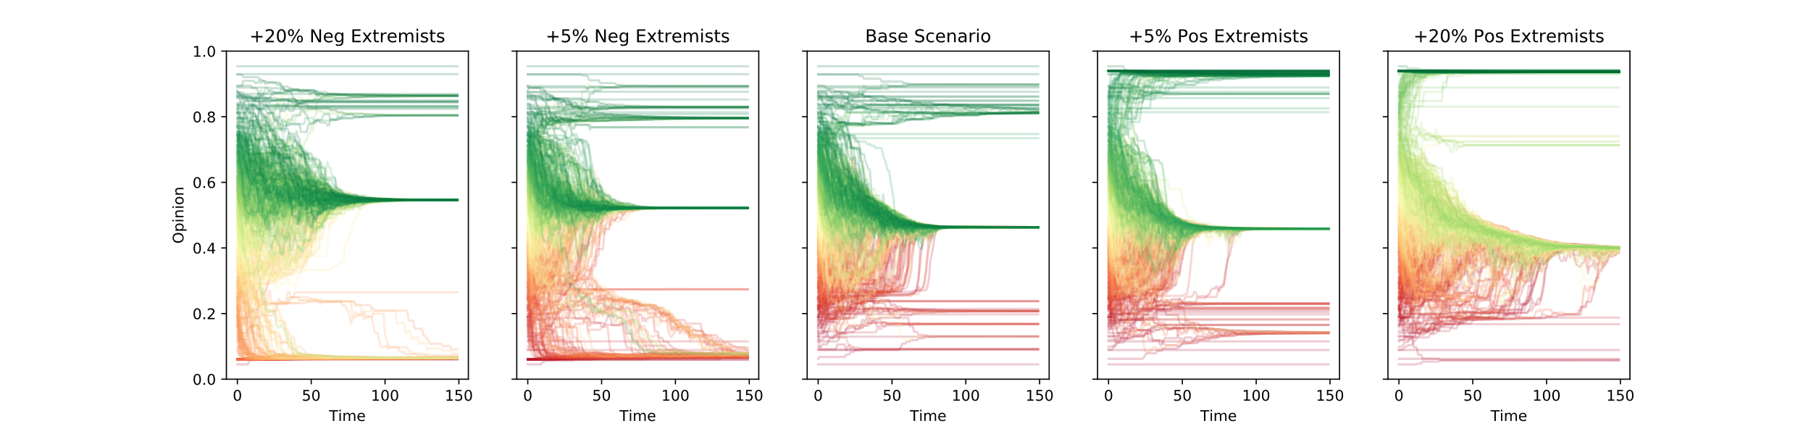

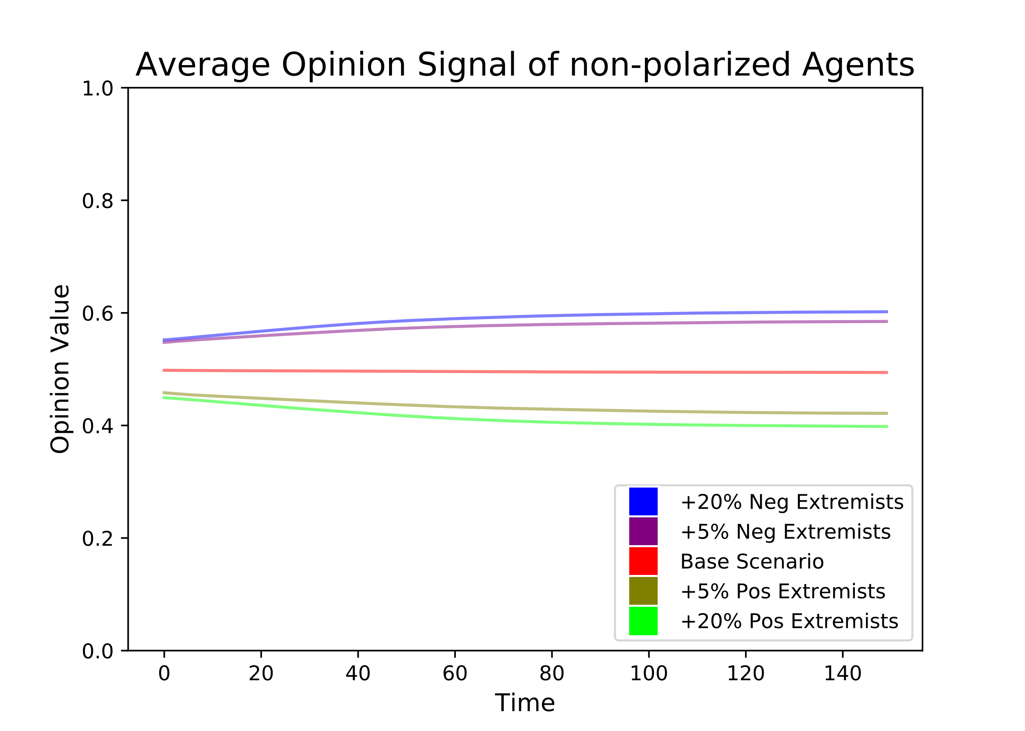
Results and Discussion
One-Sided
Extremism
RA

Slide 12
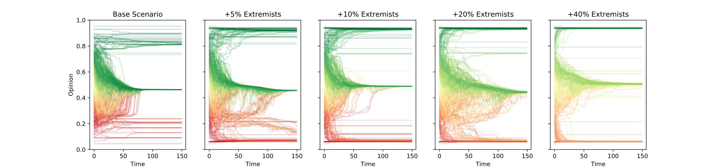
Results and Discussion
One-Sided
Extremism
Symmetric
Extremism

Slide 13
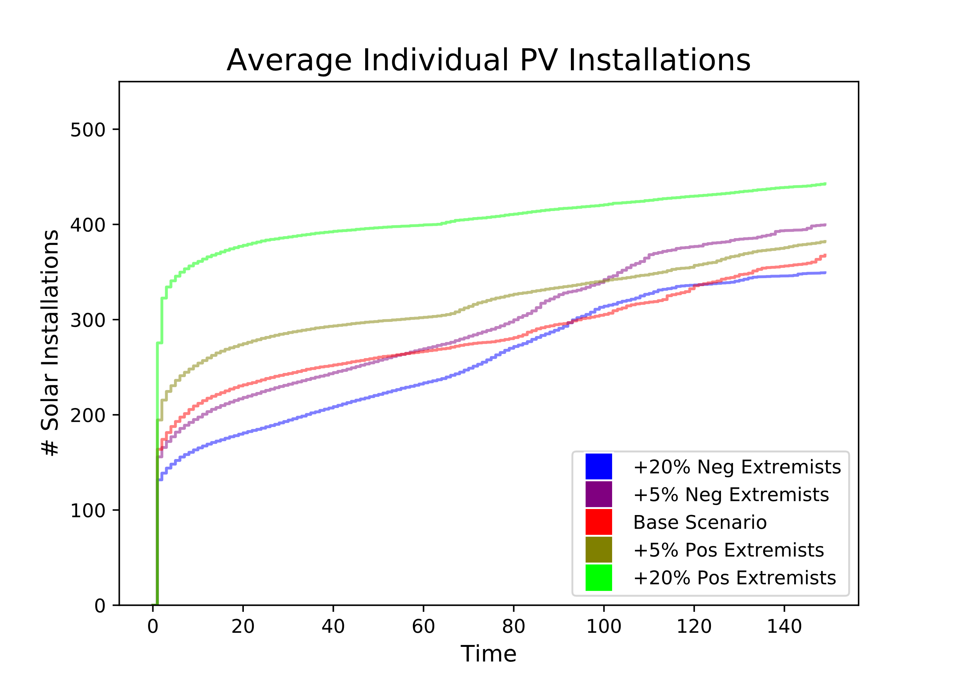
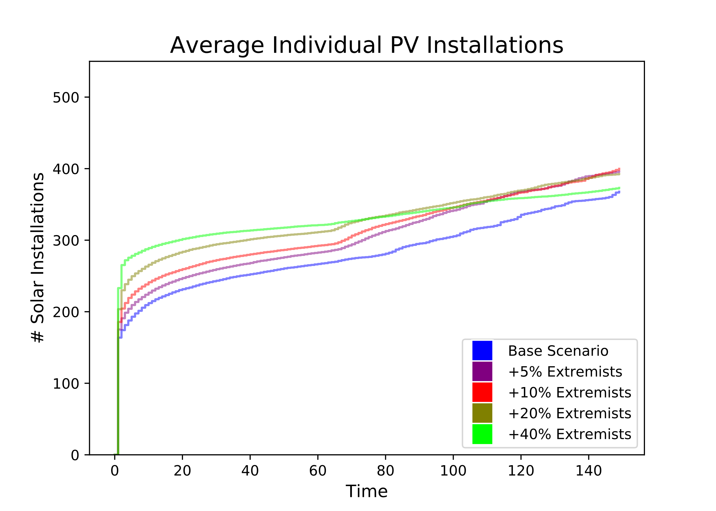
Results and Discussion
One-Sided Extremism
Symmetric Extremism

Slide 14
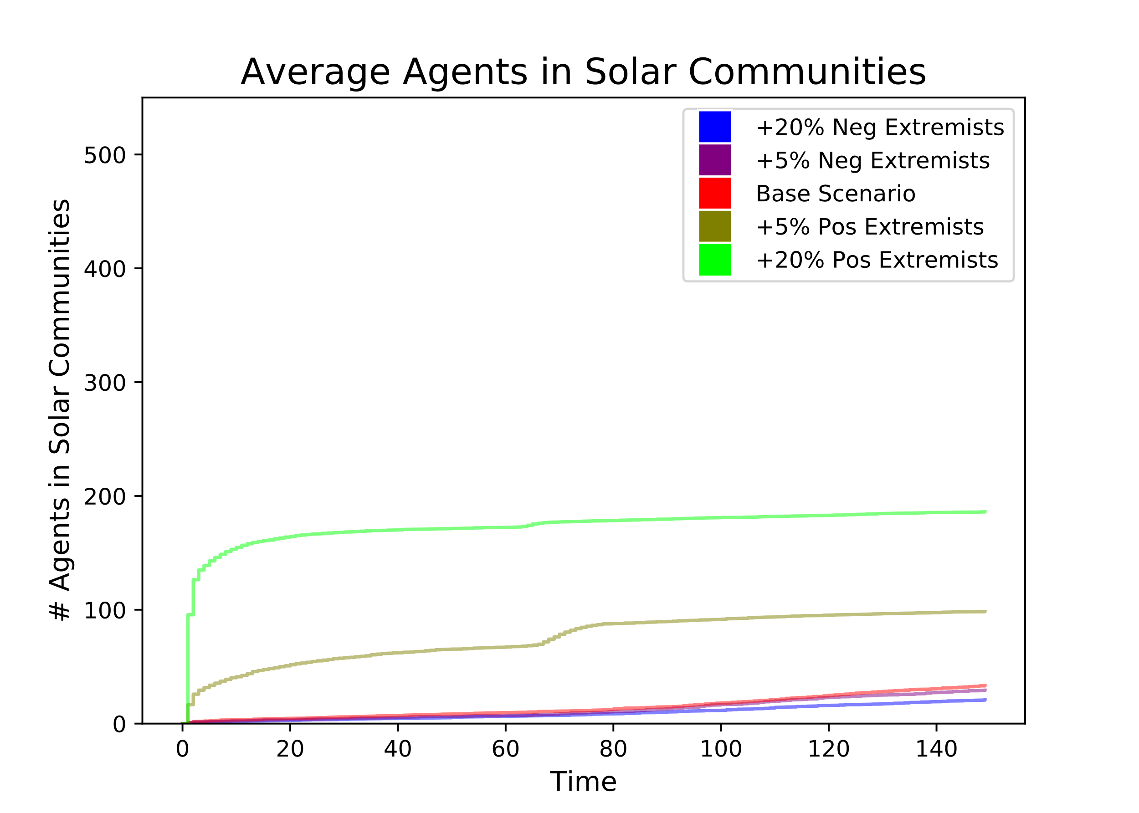
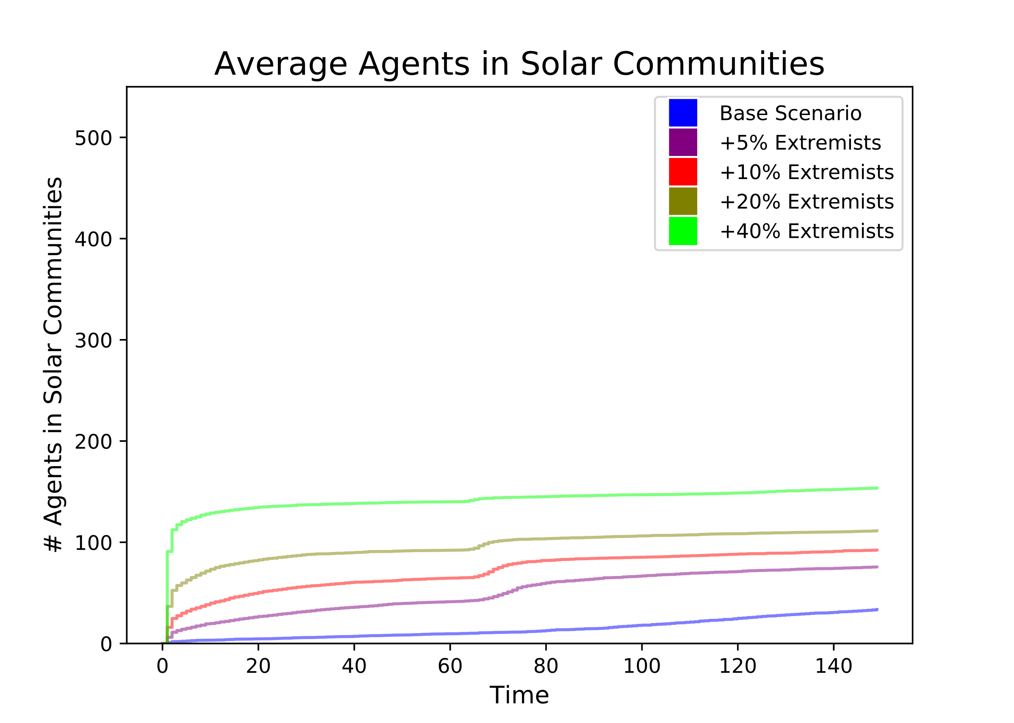
Results and Discussion
One-Sided Extremism
Symmetric Extremism

Slide 15
Results and Discussion
Conclusions
“Single-Sided” extremism
Unbalances average opinion towards that extreme
However, average opinion of non-polarized nodes shifts to the opposite extreme

Slide 16
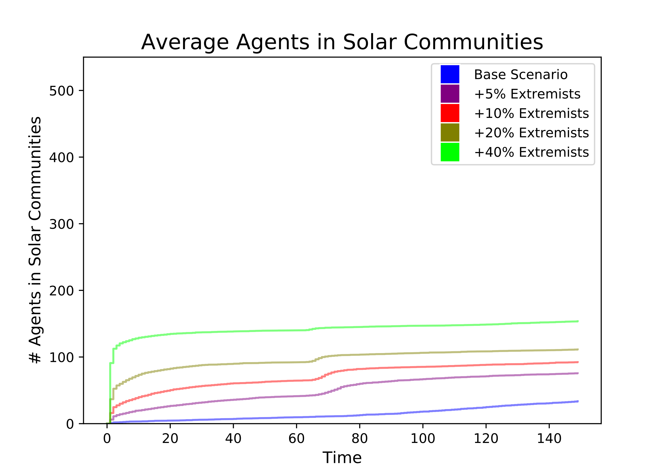
Results and Discussion
Conclusions
“Single-Sided” extremism
Unbalances average opinion towards that extreme
However, average opinion of non-polarized nodes shifts to the opposite extreme
For Communities: Benefits of Pos. Extremists > Detriment by Neg. Extremists
Neighbor Factor

Slide 17

Results and Discussion
Conclusions
“Single-Sided” extremism
Unbalances average opinion towards that extreme
However, average opinion of non-polarized nodes shifts to the opposite extreme
For Communities: Benefits of Pos. Extremists > Detriment by Neg. Extremists
Neighbor Factor
For Individual ideas: Relationship with Extremism is more complicated…
Pos. Extremists → Install immediately and try to form communities
But… Non-polarized nodes tend to compensate to the other extreme

Slide 18

Questions and Answers

Slide 19
What is the role of opinion extremists in the diffusion of individual and community solar photovoltaics in cities?
Photo: EWZ
Jordi Fornt-Mas, Sourya Kovvali, Alejandro Nuñez-Jimenez, Marius Schwarz
Project for the lecture: Agent-Based Modeling and Social System Simulation, FS-2019, ETH Zurich December 9, 2019

Slide 20
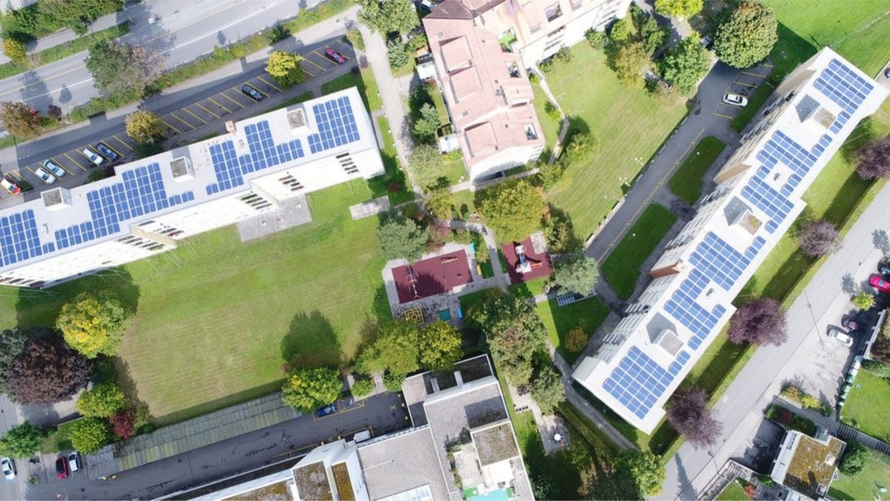
What is the role of opinion extremists in the diffusion of individual and community solar photovoltaics in cities?
Photo: ESB Energy Service, Biel/Bienne
Jordi Fornt-Mas, Sourya Kovvali,
Alejandro Nuñez-Jimenez, Marius Schwarz
Project for the lecture: Agent-Based Modeling and Social System Simulation, FS-2019, ETH Zurich December 9, 2019

